Slide 1
Santa Was a Mushroom
by Jonathan Logan
December 2024

Slide 2
Let’s Talk About the Santa Story
Lives in the north
Comes during the winter, very snowy
Is magical
Wears red fur coat
Wears boots
Brings gifts, under the tree, with ornaments
Has flying reindeer (one with a red nose)
Comes down the chimney
Works with elves

Slide 3
Hypothesis: Santa Claus is a shaman who gives out psychedelic mushrooms as gifts.

Slide 4
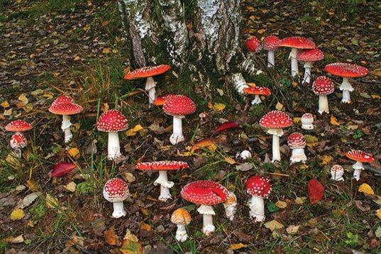
Amanita muscaria (the Holy Mushroom)
found under the trees in the winter

Slide 5
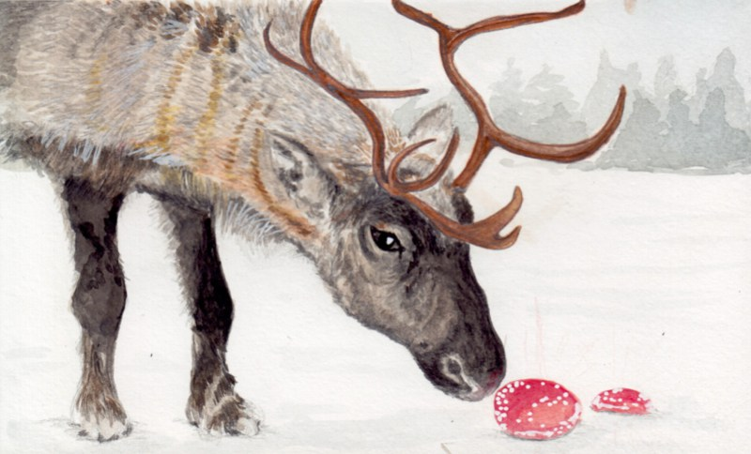
Science Editor… Andrew Hayes

Slide 6
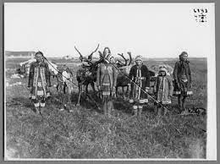
“Shaman” originates in Russia.
Medicine man, sorcerer, magician

Slide 7
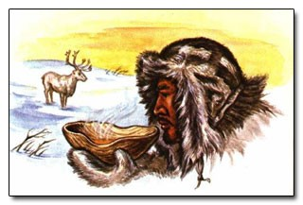
Shaman drink reindeer urine & new Initiates drink Shaman urine
18th Century Report… Philip Johann von Strahlenberg

Slide 8
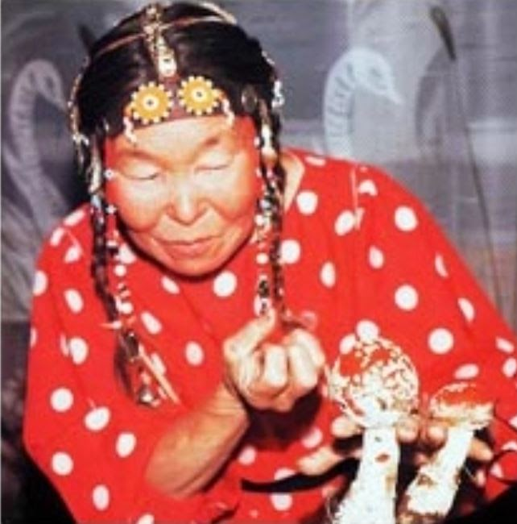

Slide 9
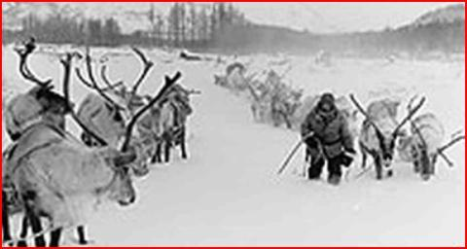

Slide 10
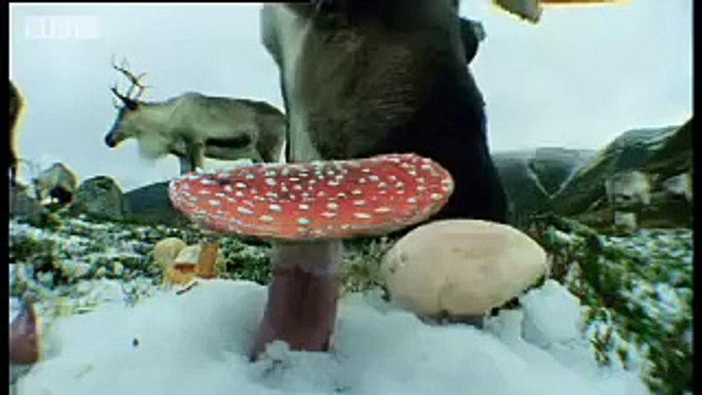

Slide 11
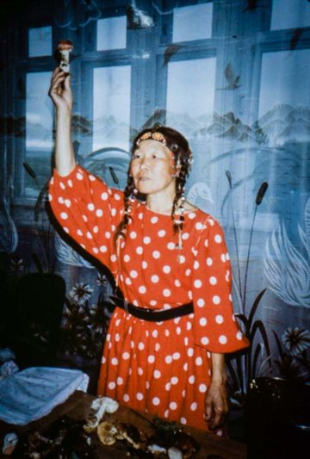

Slide 12
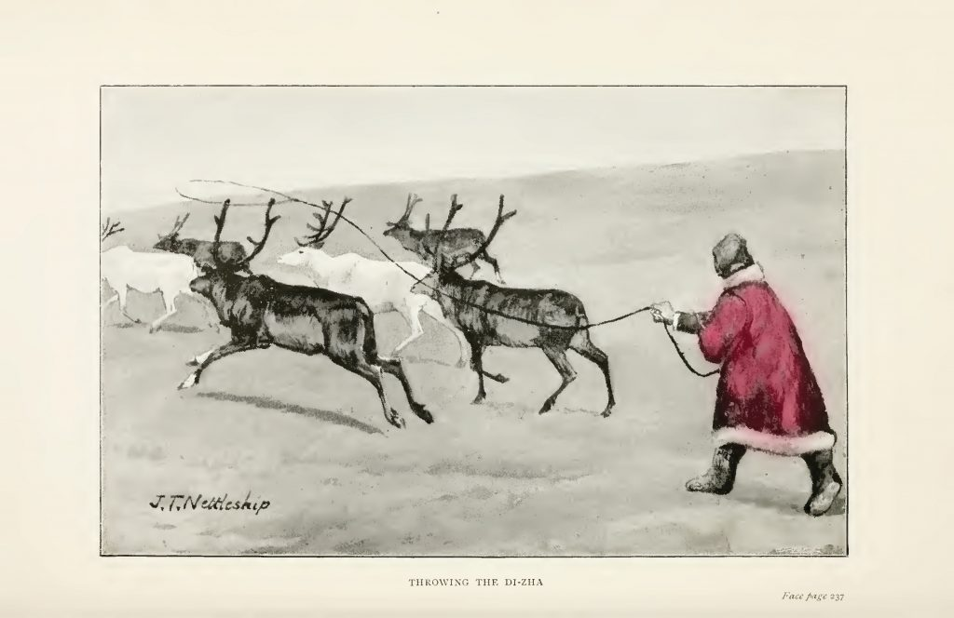

Slide 13
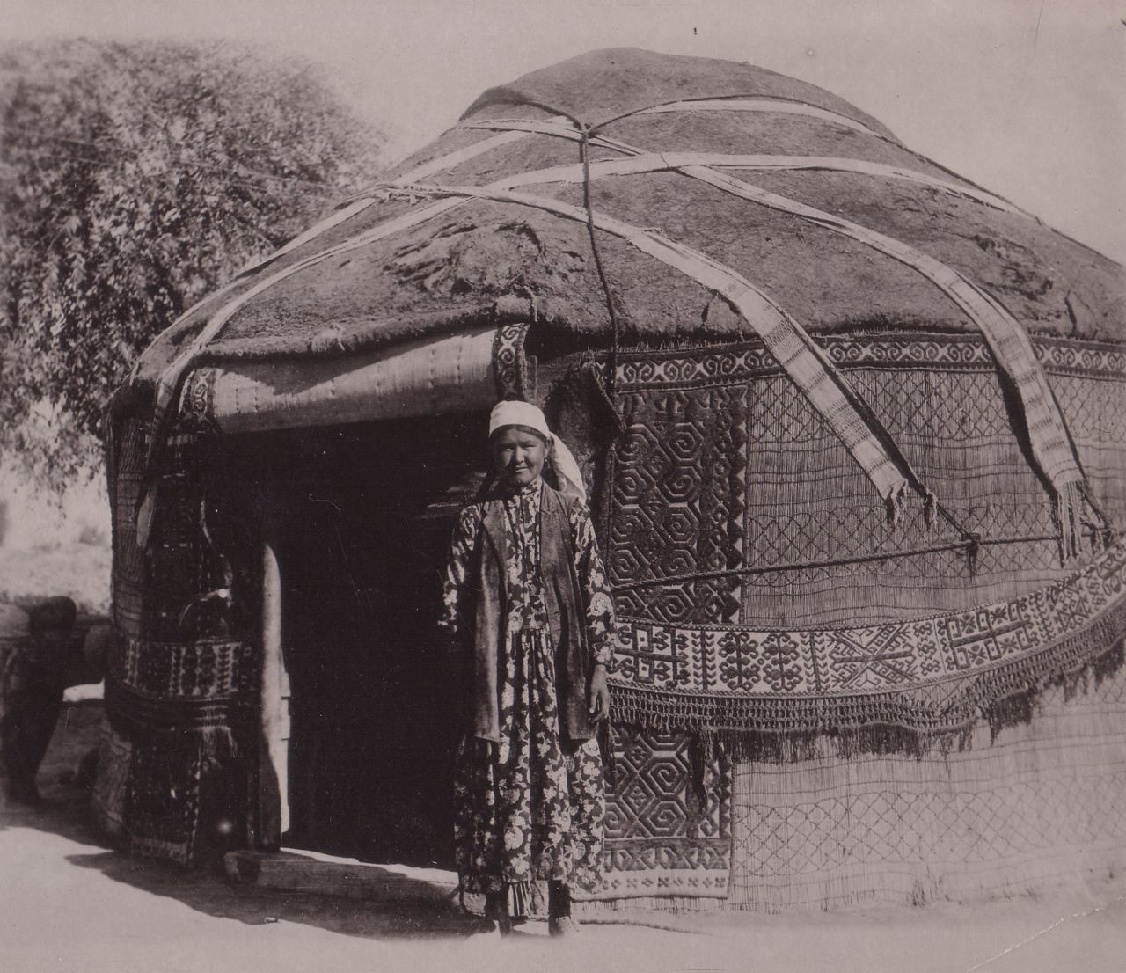

Slide 14
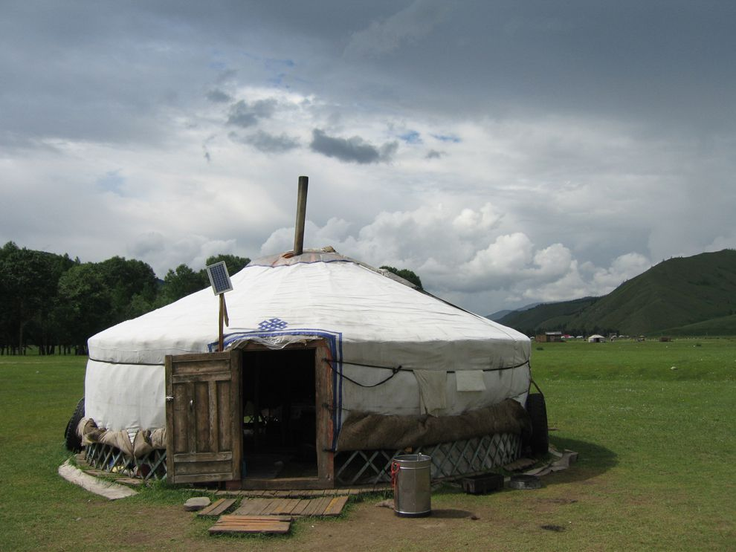

Slide 15
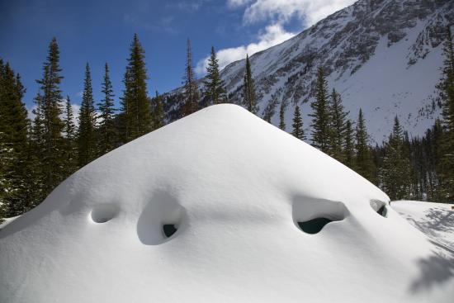

Slide 16
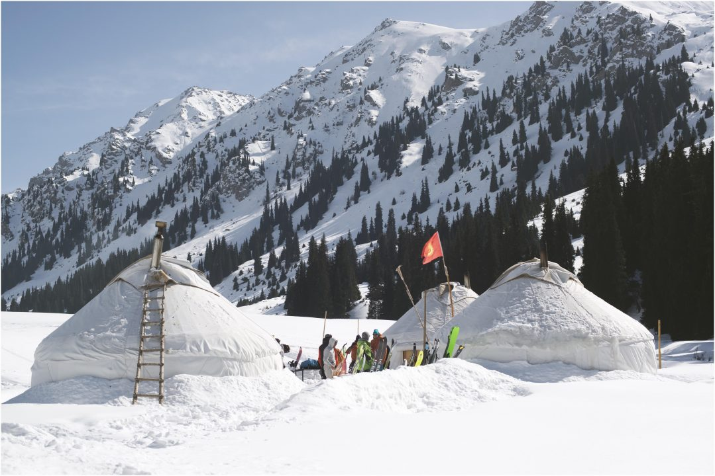
During the winter, people climb into Yurt through the smoke hole
NY Times Editor… Mathew Salton

Slide 17
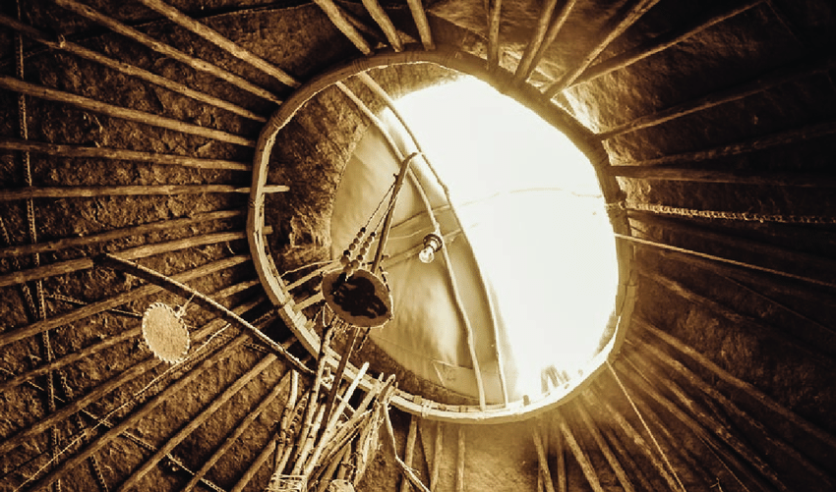

Slide 18
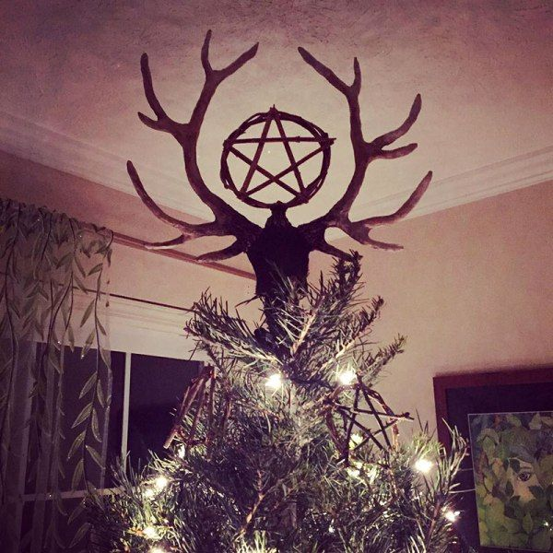

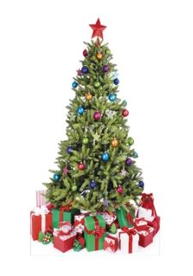
Pagans would cut trees and bring them inside to decorate.

Slide 19
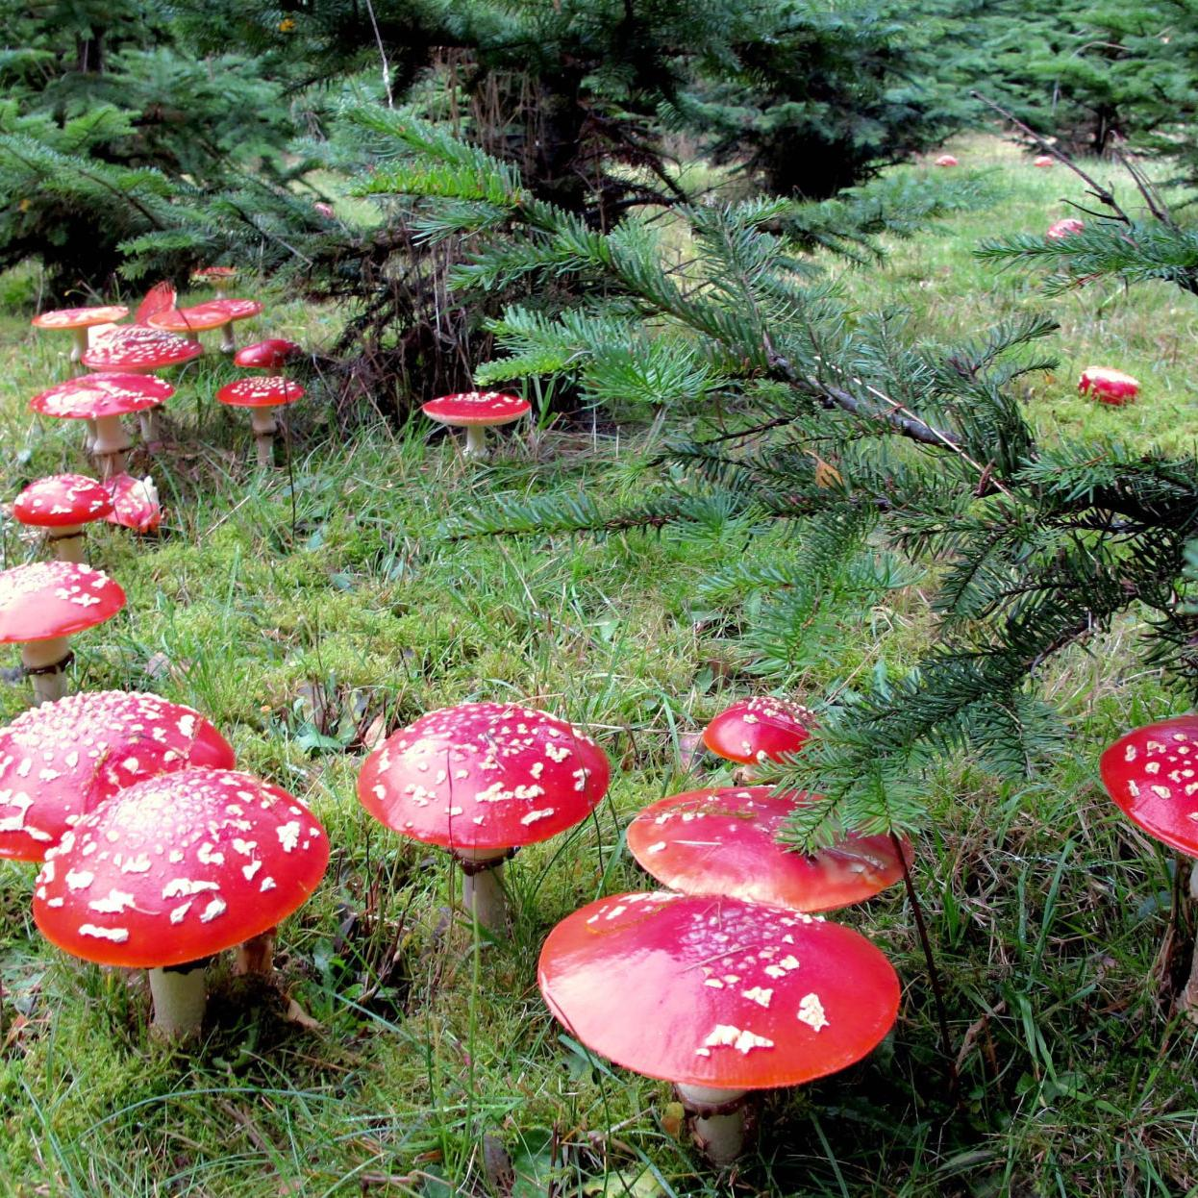
Presents are found under the tree and ornaments are hanging on the tree
Mushrooms and Mankind… James Arthur

Slide 20
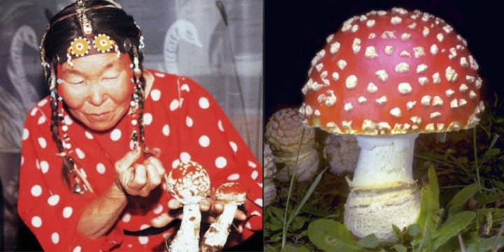
The Samis of Lapland (in northern Finland) dry their “healing” mushrooms by hanging them on evergreen trees.
NY Times Editor… Mathew Salton

Slide 21
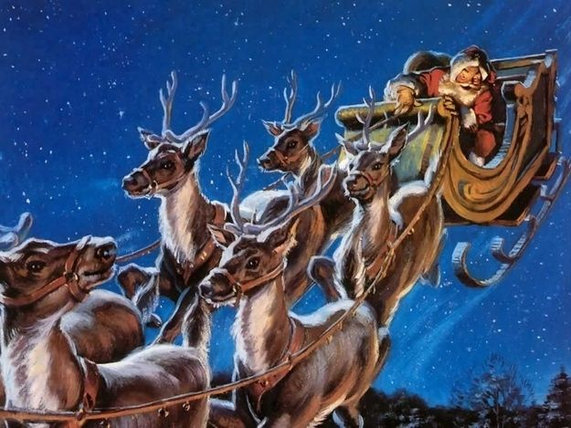
The feeling of flying is common on psychedelics.
Mycologist… Paul Stamets

Slide 22
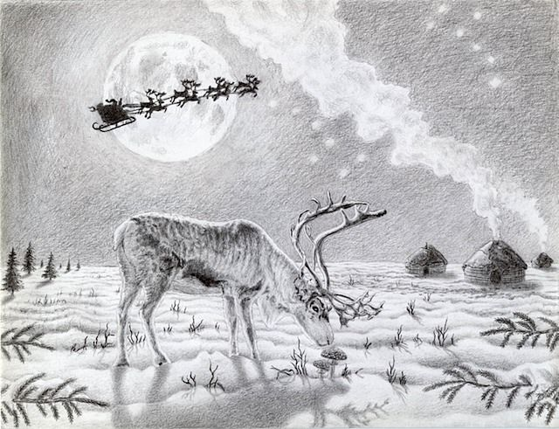

Slide 23
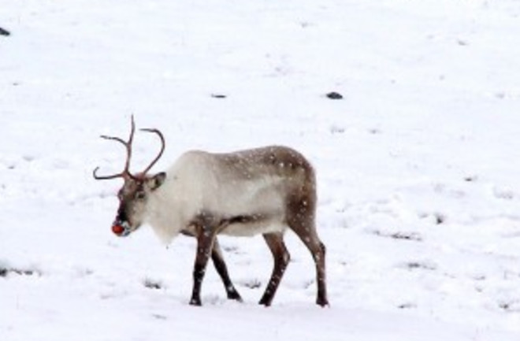
Rudolph’s red nose symbolizes the Amanita Mushroom
Classics Professor… Carl Ruck

Slide 24
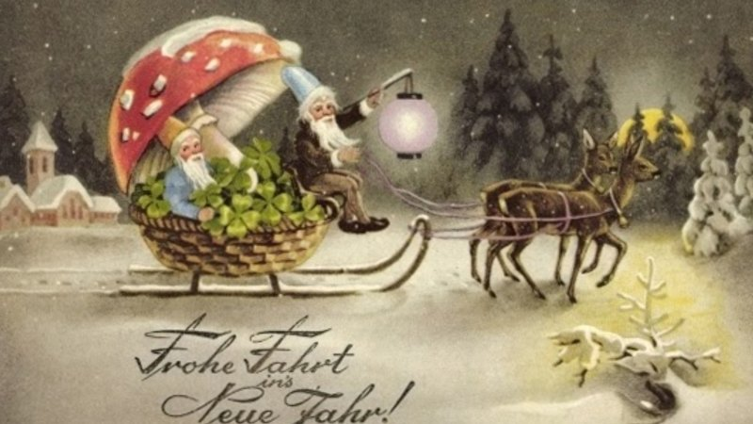

Slide 25
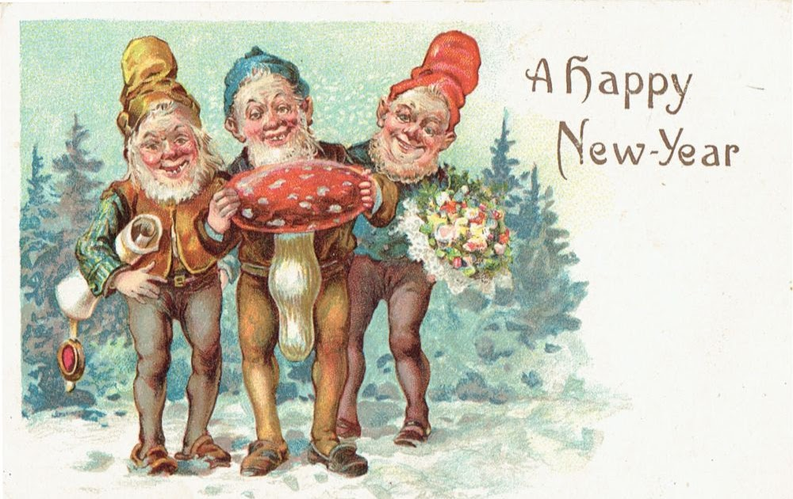
Visions of small people are common on psychedelics
Mycologist… Paul Stamets

Slide 26
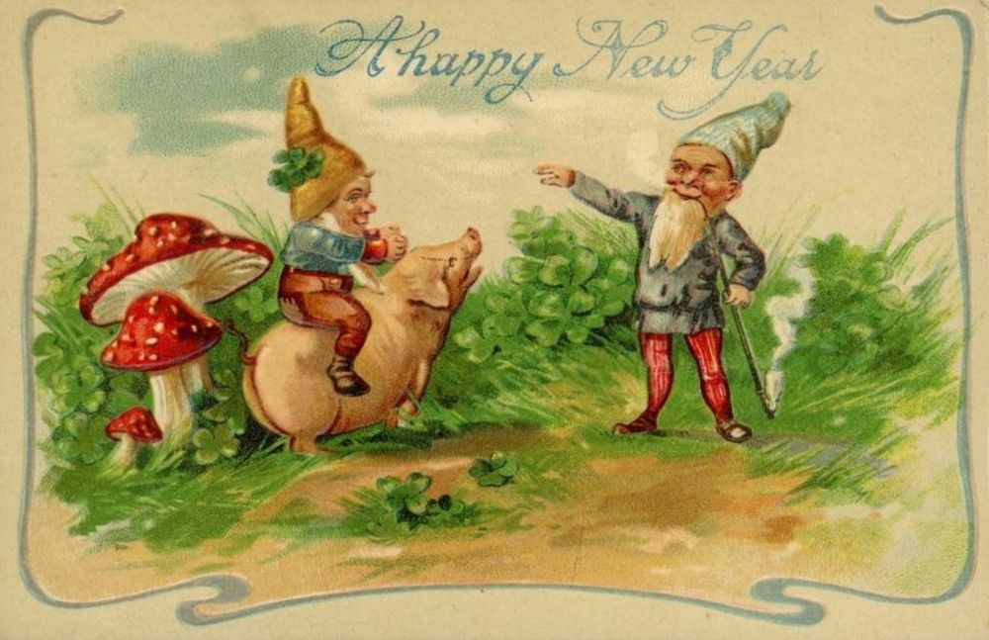
Pigs are used to sniff out certain mushrooms

Slide 27
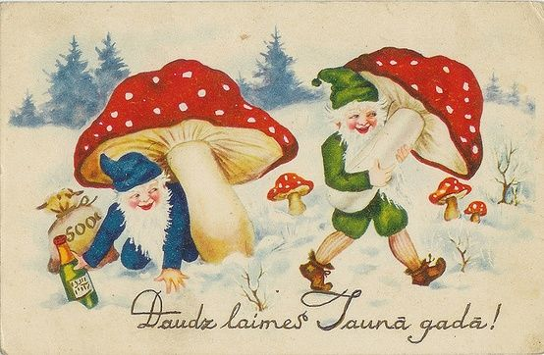

Slide 28
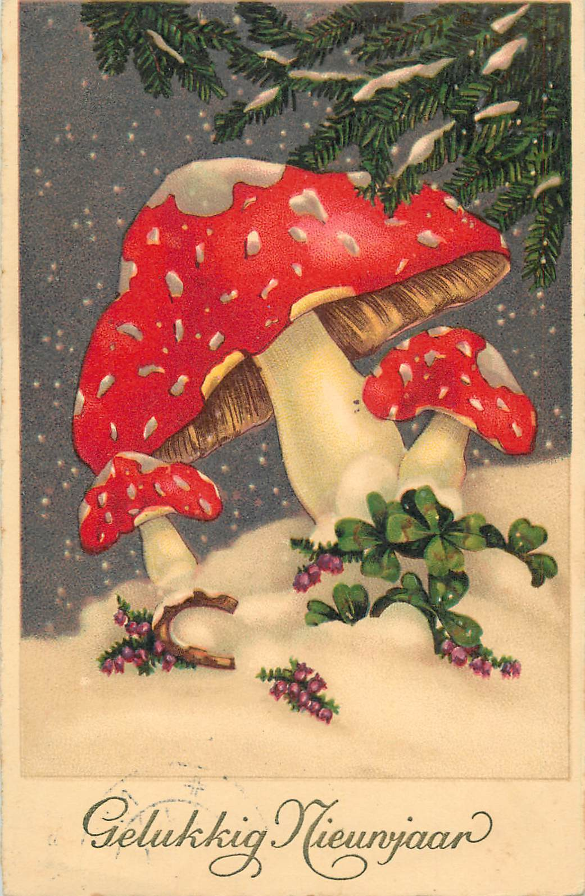

Slide 29
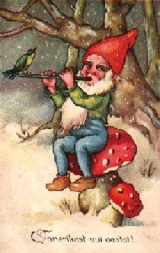

Slide 30
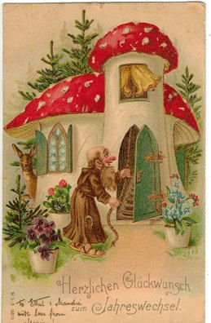

Slide 31
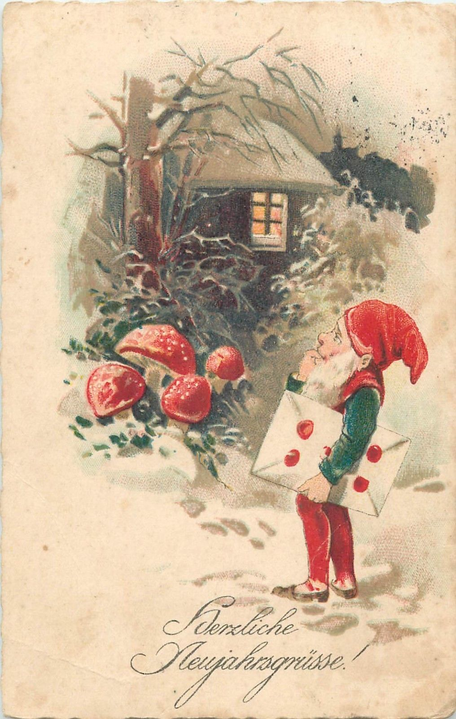

Slide 32
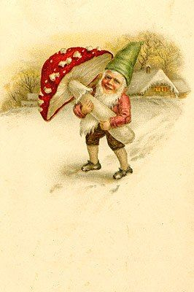

Slide 33
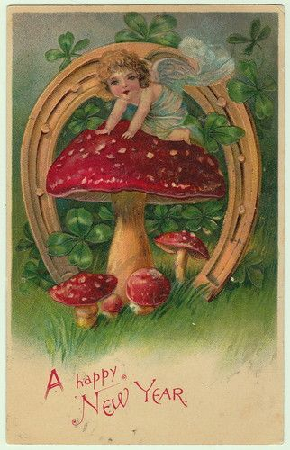

Slide 34
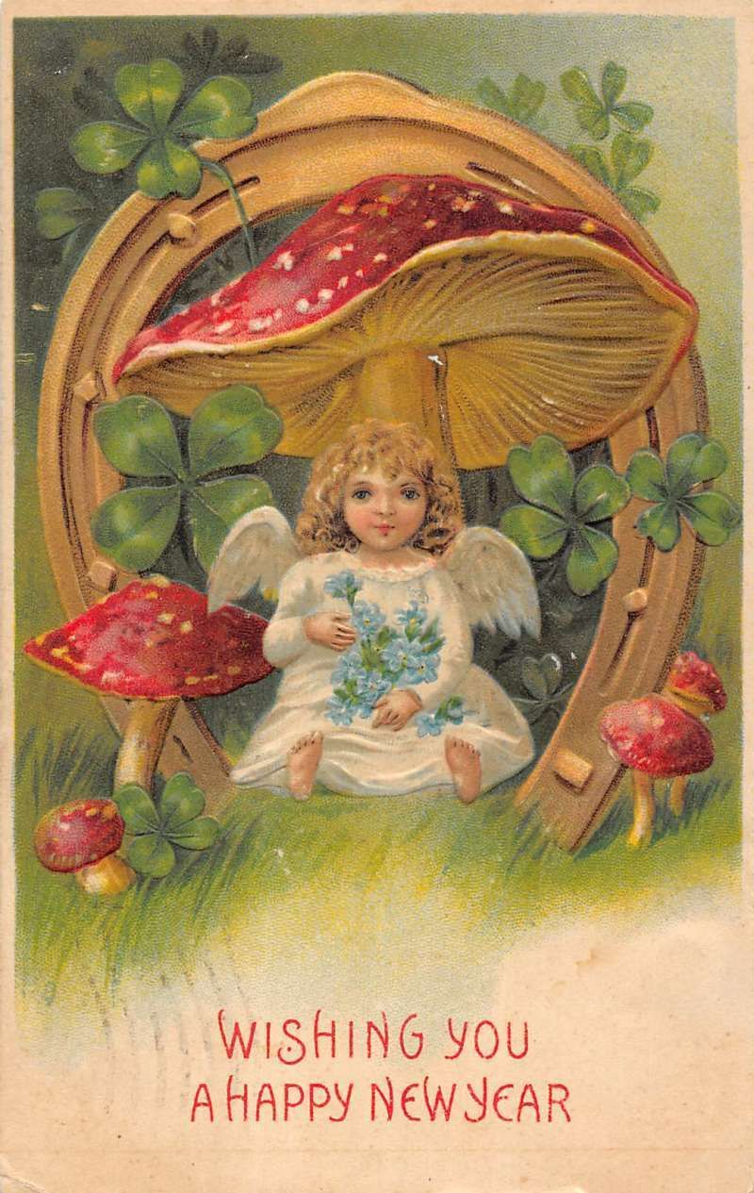

Slide 35
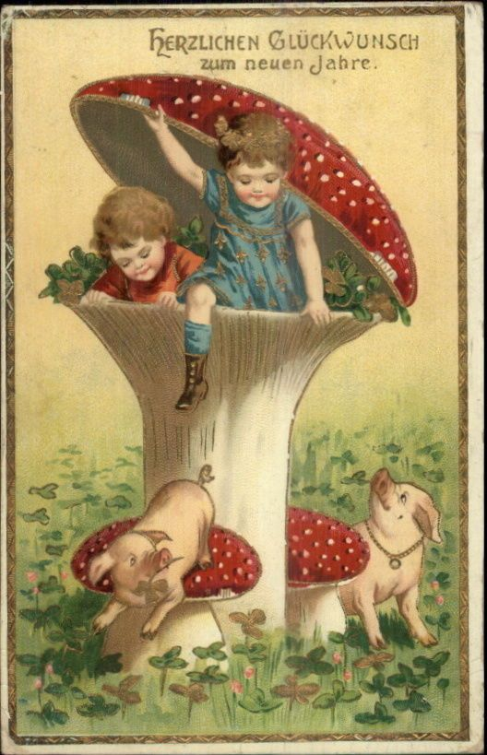

Slide 36
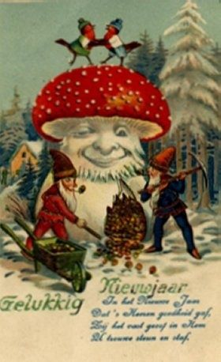

Slide 37
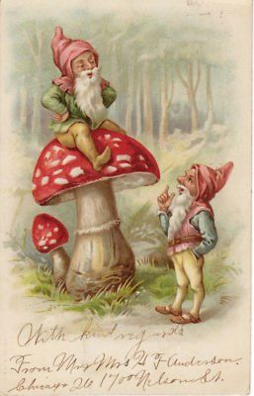

Slide 38
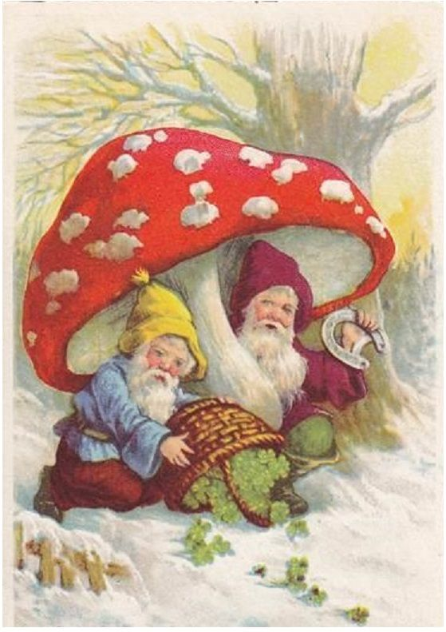

Slide 39
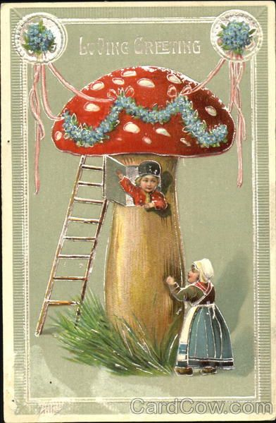

Slide 40
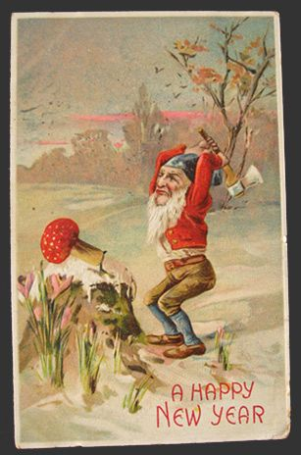

Slide 41
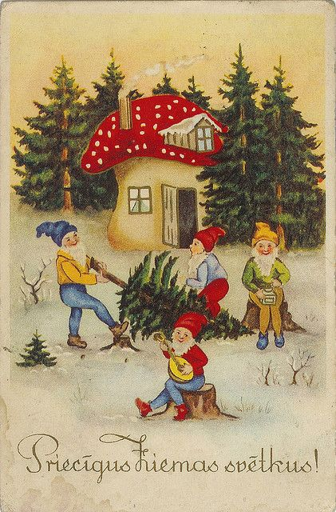

Slide 42
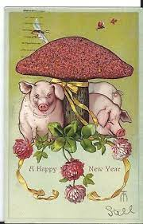

Slide 43
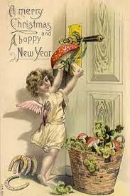

Slide 44
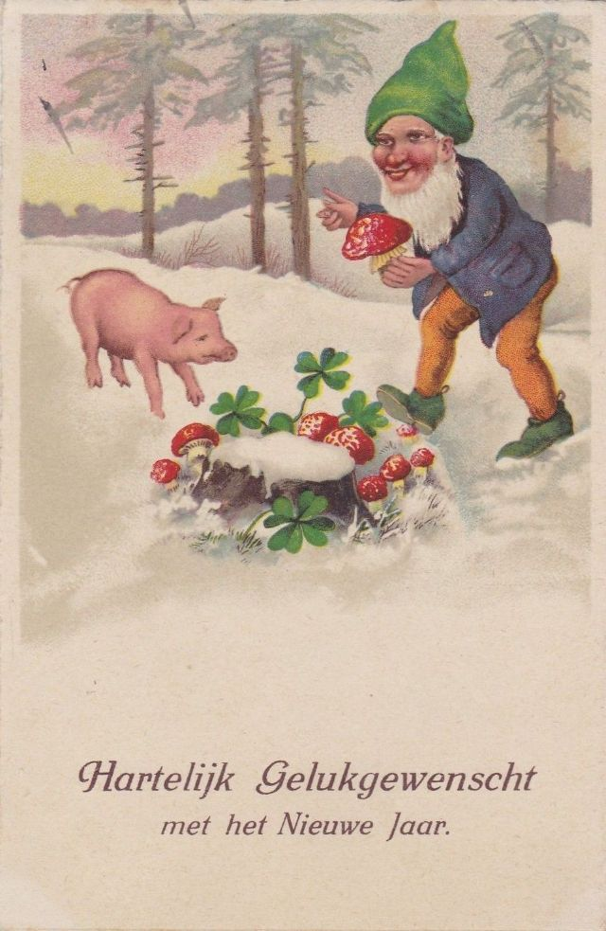

Slide 45
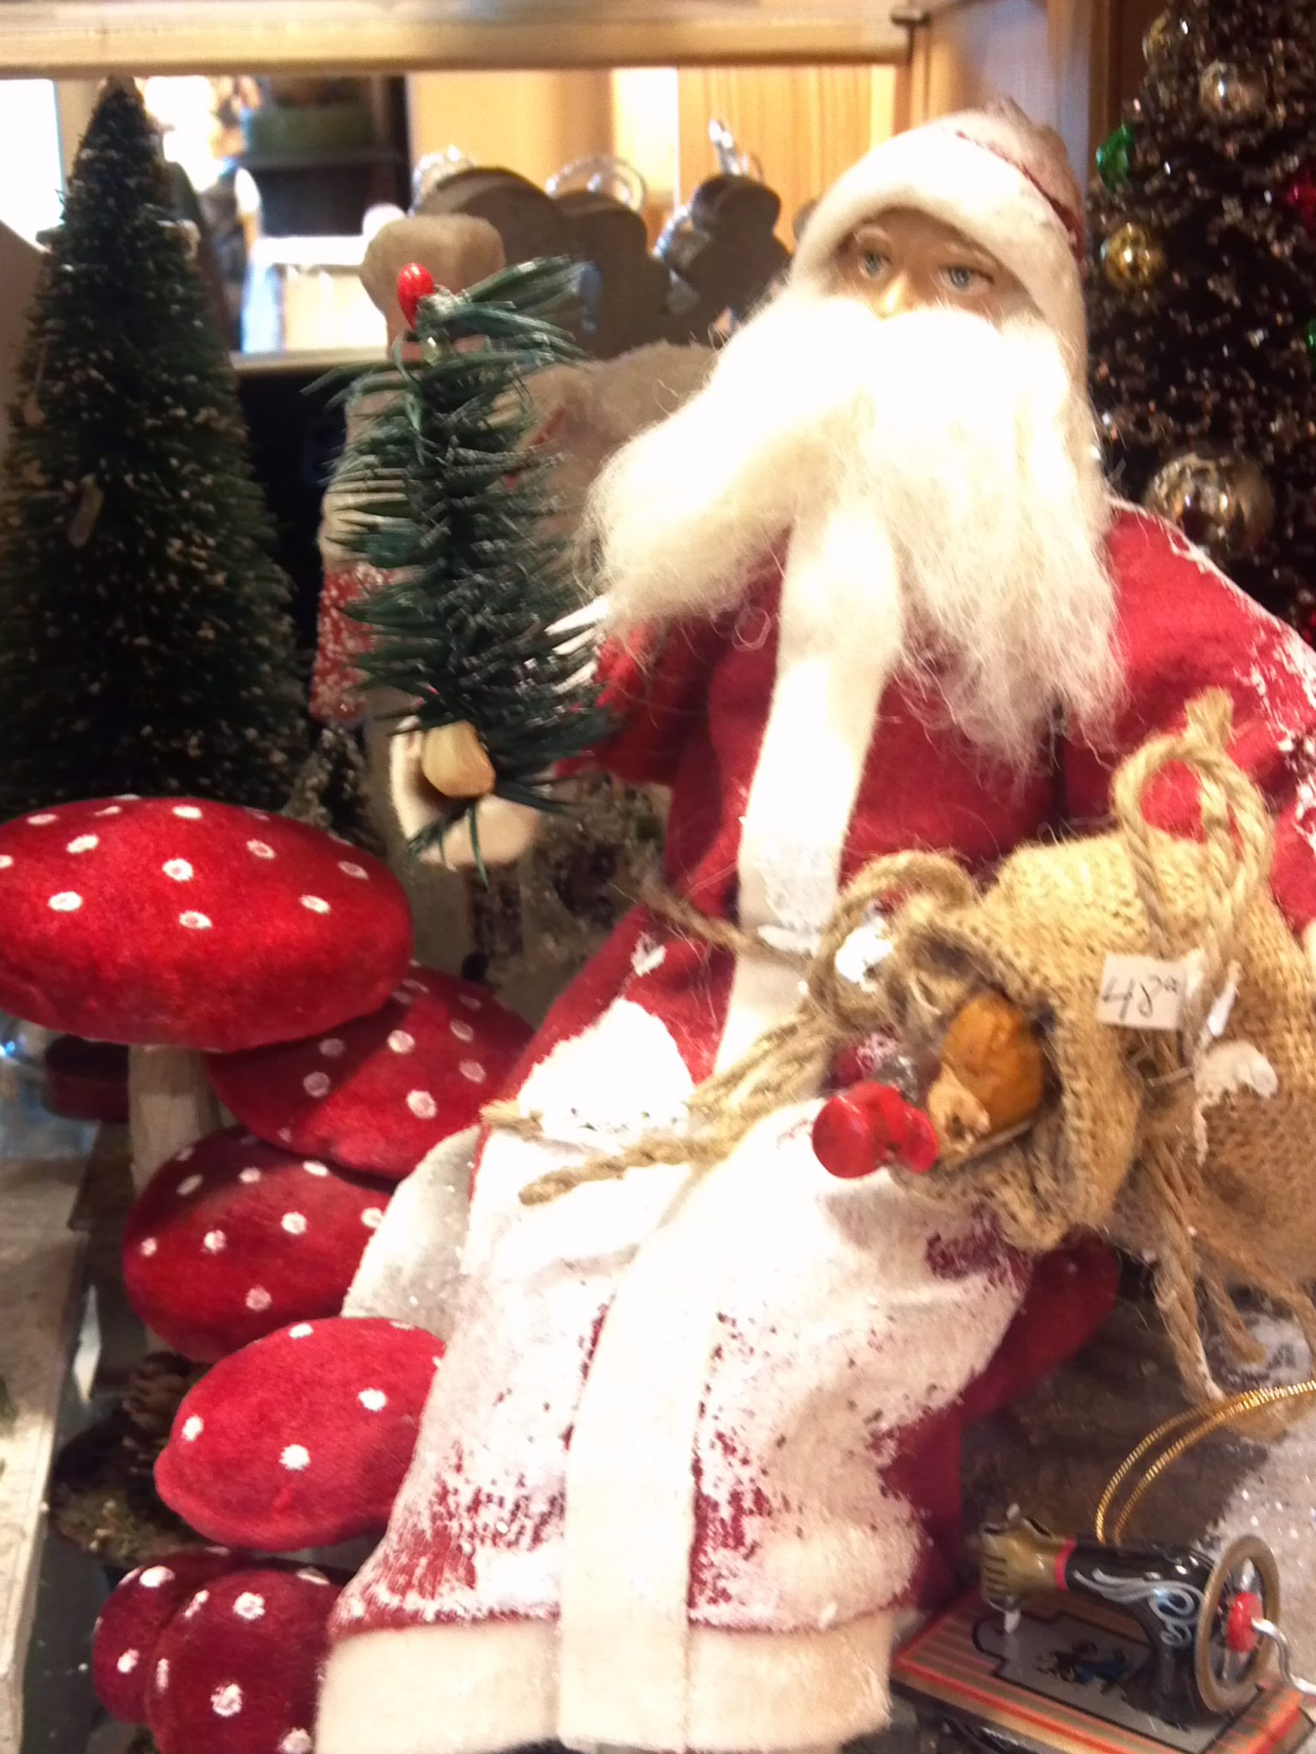

Slide 46
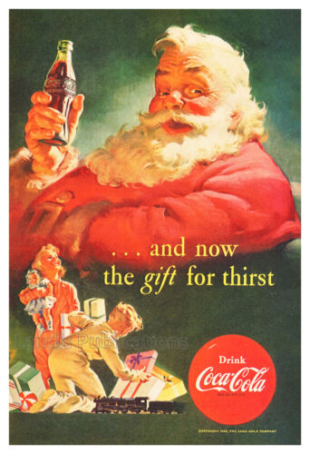
Santa’s dress code and Coke a Cola have taken commercialization to the next level

Slide 47
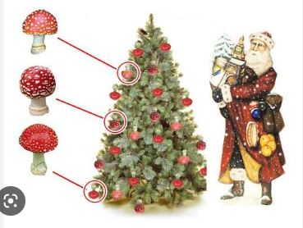
“Santa Claus, a man dressed like a psychedelic mushroom who is reborn every year, flying around the world bringing healing gifts to everyone, yet is never seen by a soul” …Eliade

Slide 48
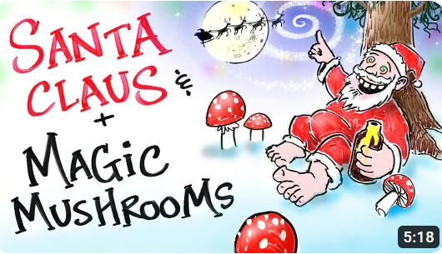

Slide 49
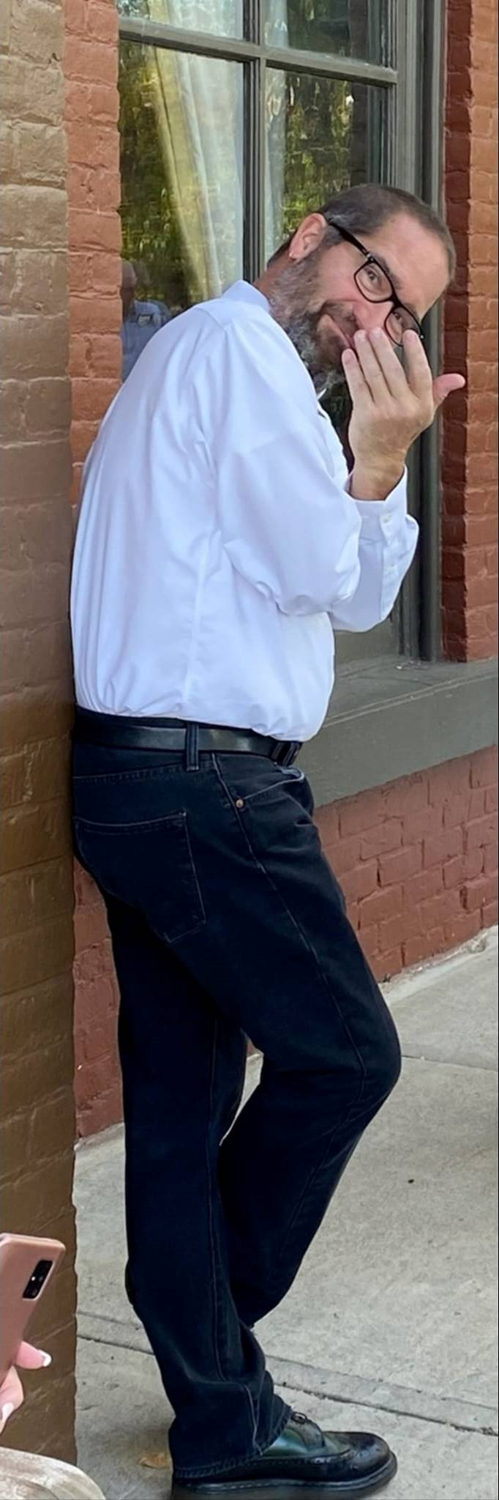
Always Ask Why!
jonathan logan
December 2024

